Slide 1
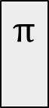
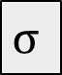

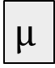

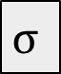

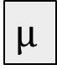
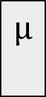
x
$$μ$$
x
$$μ$$
$$μ$$
$$θ$$
q(z|x)
z
p(x|z)
$$σ$$
$$θ$$
$$π$$
x
x
$$μ$$
z
q(z|x,y)
p(x|z,y)
$$σ$$
y
y

Slide 2
ZB4171 Generative models for spatial omics
Ernest Oh
Joseph Lee

Slide 3
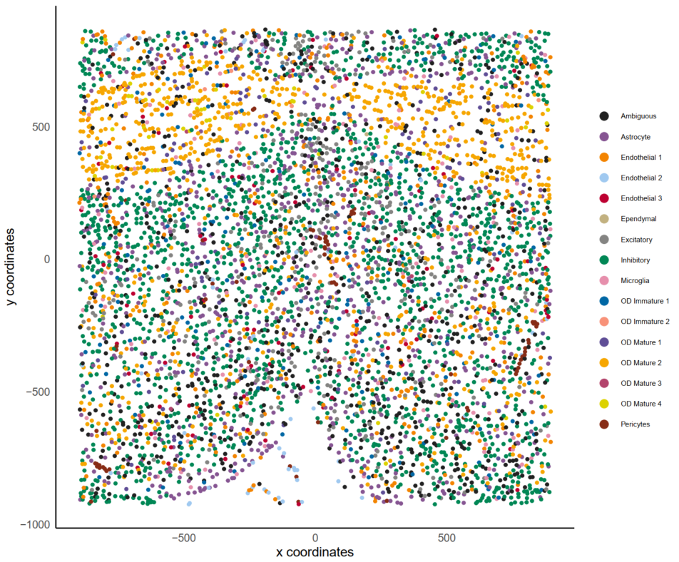
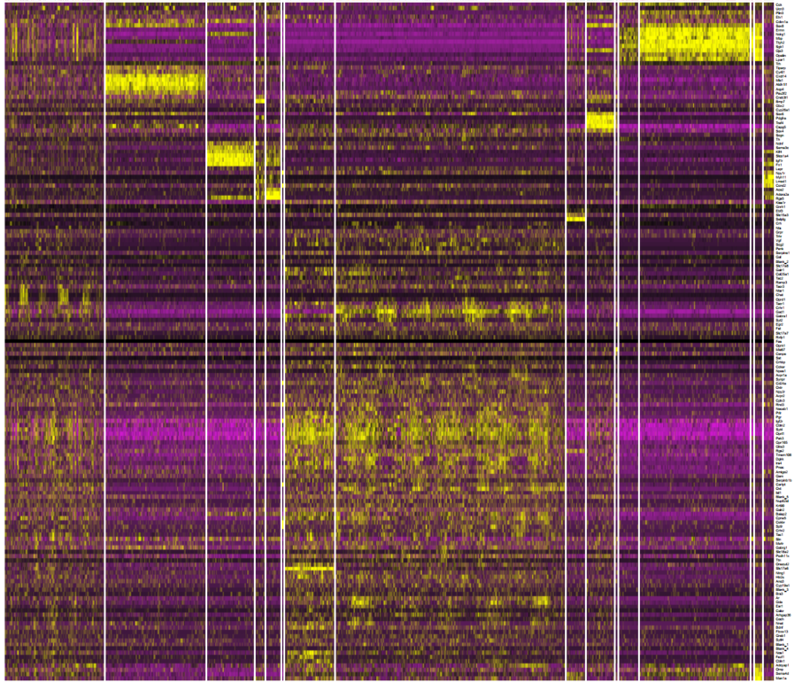
Recap
Inputs:
For each cell - gene expression + spatial locations
Data: MERFISH, ST, seqFISH+
“Moffitt” dataset

Slide 4
Recap
Inputs:
For each cell - gene expression + spatial locations
Data: MERFISH, ST, seqFISH+
Objective:
Develop a (deep) probabilistic generative model to jointly model features
GANs / VAEs conditioned on spatial neighbors i.e. CGANs, CVAEs

Slide 5
Distributional assumptions on count data

Slide 6
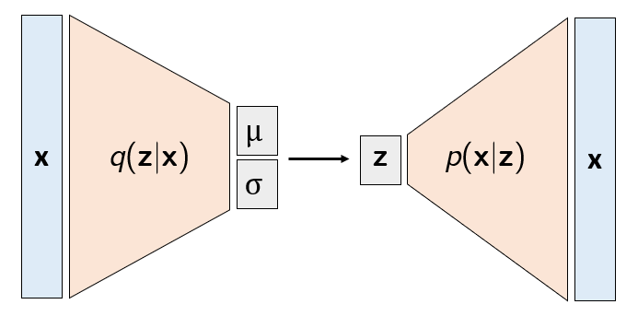
Variational Autoencoders
Encoder q(z|x)
Decoder p(x|z)
Training:
Train-val split: 80-20
3 hidden layers with 128 nodes per layer
Latent z: 10D Gaussian
Epochs: 70 - 1000
Duration: < 10 mins
Reconstruction
Regularizer
min {${−𝔼}_{z∼q(z|x)}$ [log p(x|z)] + $D_{KL}$(q(z|x) || p(z))}

Slide 7
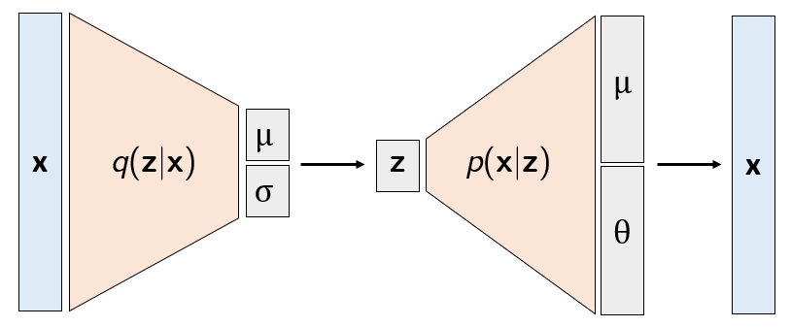
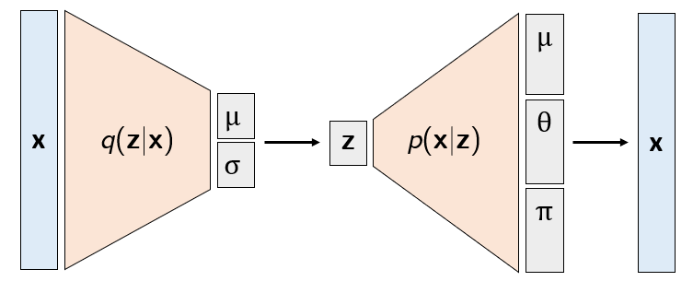
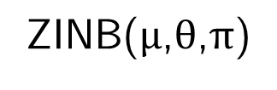
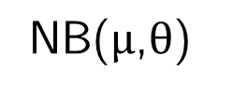
Sampling from the decoder
Choosing a distribution for p(x|z) - NB or ZINB?
NB($μ$,$θ$)
ZINB($μ$,$θ$,$π$)

Slide 8
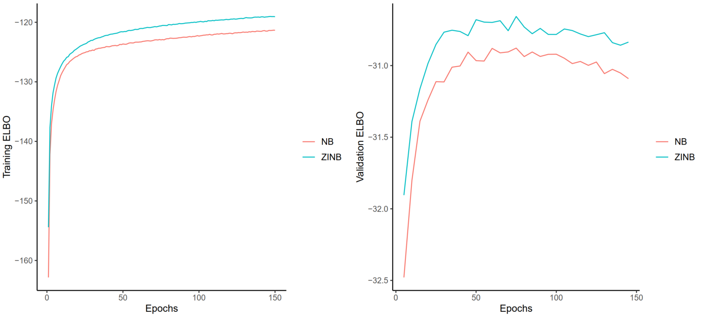
VAE - NB vs. ZINB
Minimizing the loss = maximizing the evidence lower bound (ELBO)

Slide 9
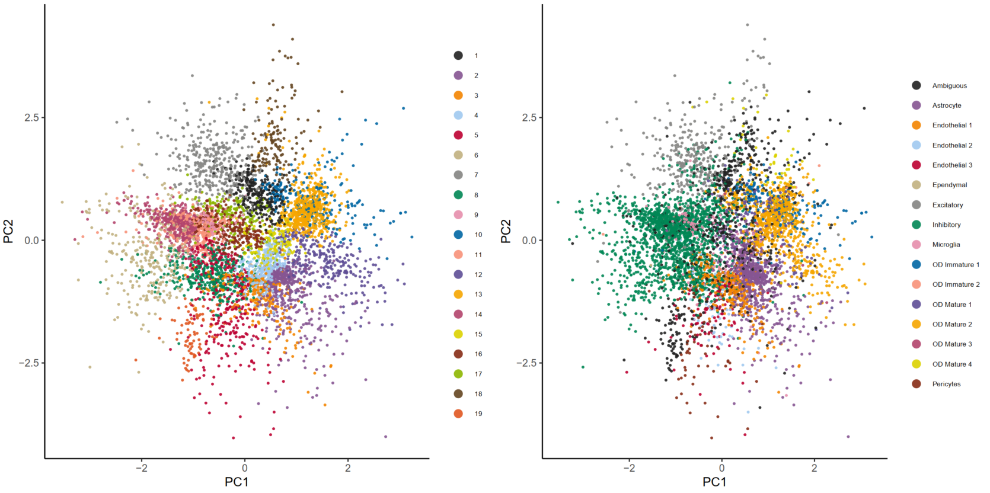
Vanilla VAEs capture cellular heterogeneity
Exploring the latent space z - PCA
Leiden clusters
Ground truth labels

Slide 10
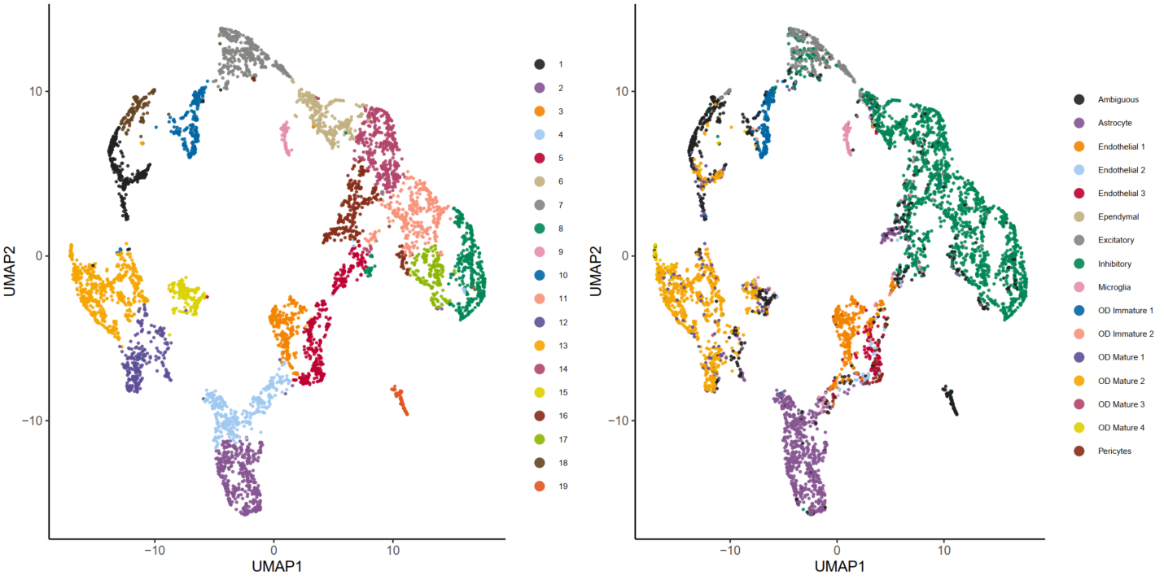
Vanilla VAEs capture cellular heterogeneity
Exploring the latent space z - UMAP
Leiden clusters
Ground truth labels

Slide 11
Conditional VAEs (CVAEs)
Back to the objective: how does expression depend on spatial neighborhood?
Formulate this probabilistically: p(x|y)
Inference with CVAEs

Slide 12
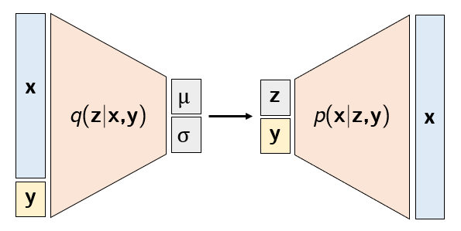
Conditional VAEs (CVAEs)
Inputs to the encoder and decoder are conditioned by an input y
E.g. y: cell type labels, spatial neighbors
How to encode?
Categorical cell type label: one-hot [0,0,1,...,0,0]
Spatial neighborhood?

Slide 13
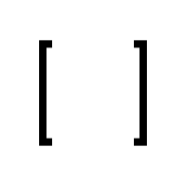
CVAE conditioned on spatial neighbors
1. Select k nearest neighbors
2. Merge neighbor expression to obtain context y
1
k
x = g
y = g
3. Resolve incompatible dimensions by replicating
own expression
4. Train
5. Squeeze z and x back to original dimensions
1 x k
k
x = g
y = g

Slide 14
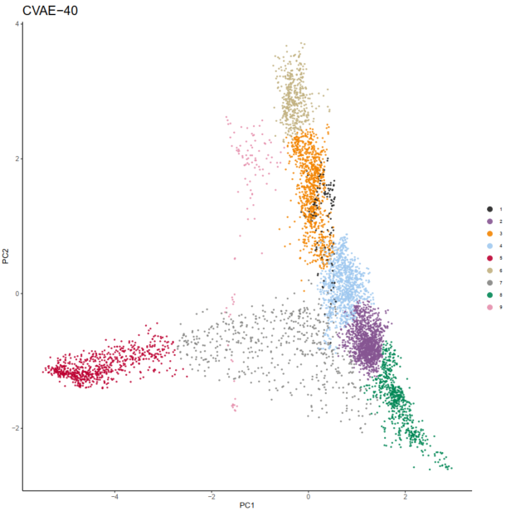
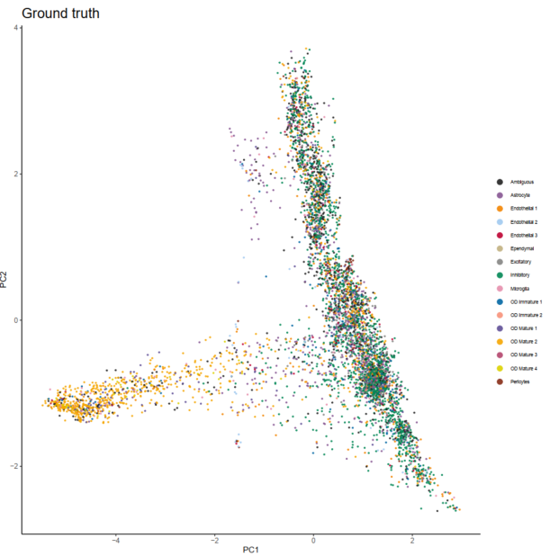
CVAE encodes spatial structure
Exploring the latent space z - PCA
Leiden clusters
Ground truth labels

Slide 15
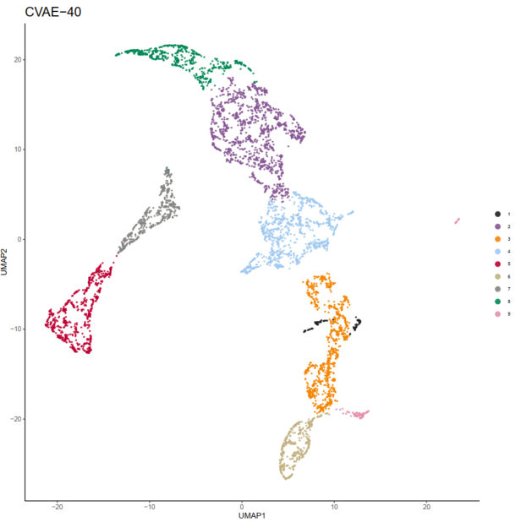
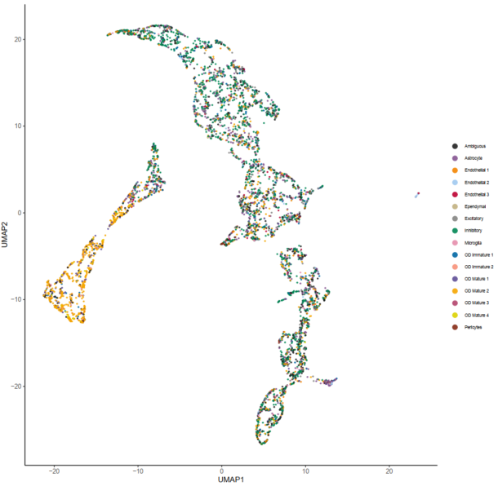
CVAE encodes spatial structure
Exploring the latent space z - UMAP
Leiden clusters
Ground truth labels

Slide 16
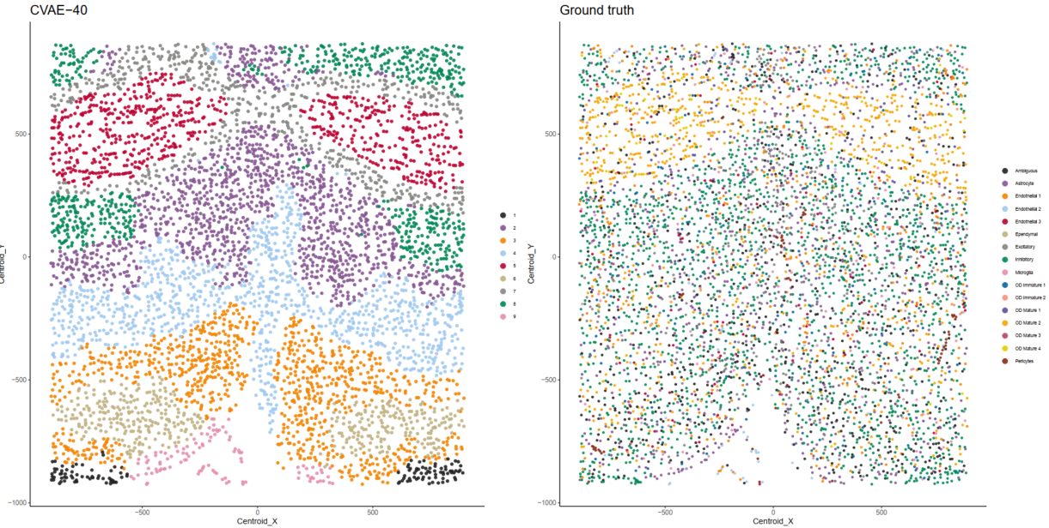
CVAE encodes spatial structure
How do the clusters look like in physical space?
Leiden clusters
Ground truth labels

Slide 17
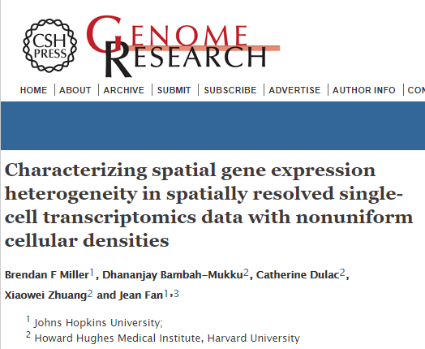
CVAE encodes spatial structure
Do these clusters mean anything?
Sanity check: benchmark against another spatial clustering algorithm
MERINGUE

Slide 18
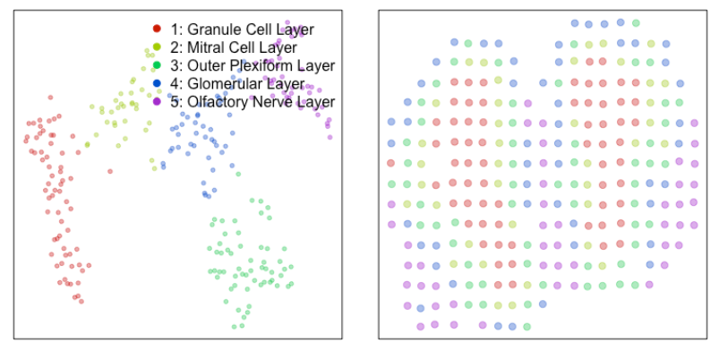
CVAE encodes spatial structure
MERINGUE on the mouse olfactory bulb ST dataset - 260 spots, 7000+ genes
https://github.com/JEFworks-Lab/MERINGUE/blob/master/docs/mOB_analysis.md

Slide 19
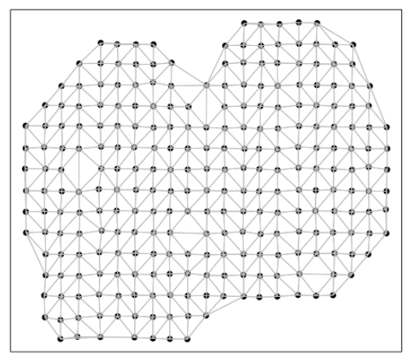
CVAE encodes spatial structure
MERINGUE on the mouse olfactory bulb ST dataset - 260 spots, 7000+ genes
https://github.com/JEFworks-Lab/MERINGUE/blob/master/docs/mOB_analysis.md

Slide 20
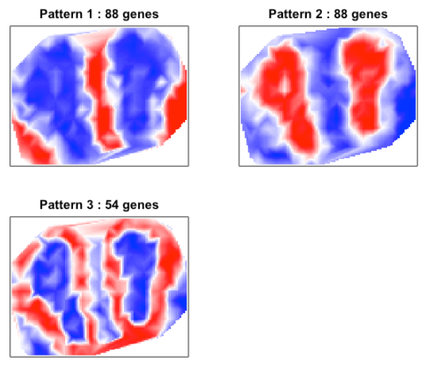
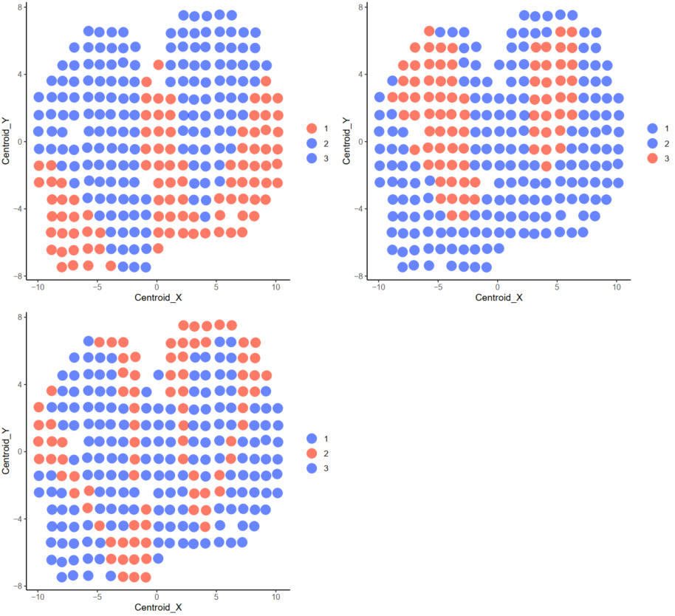
CVAE encodes spatial structure
MERINGUE interpolated signal of spatial patterns
CVAE clusters

Slide 21
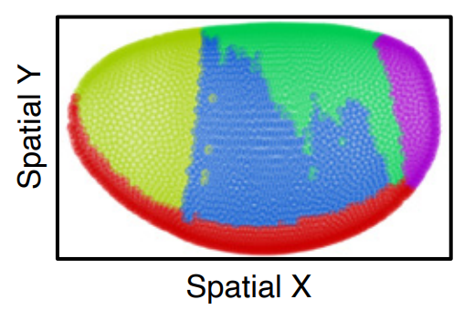
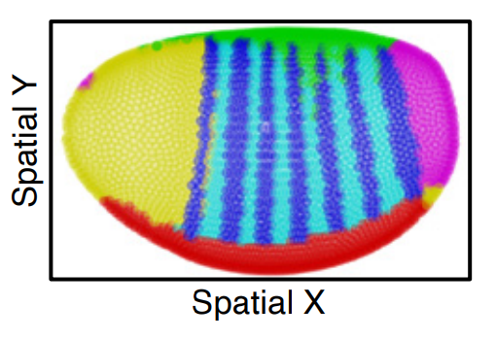

Slide 22
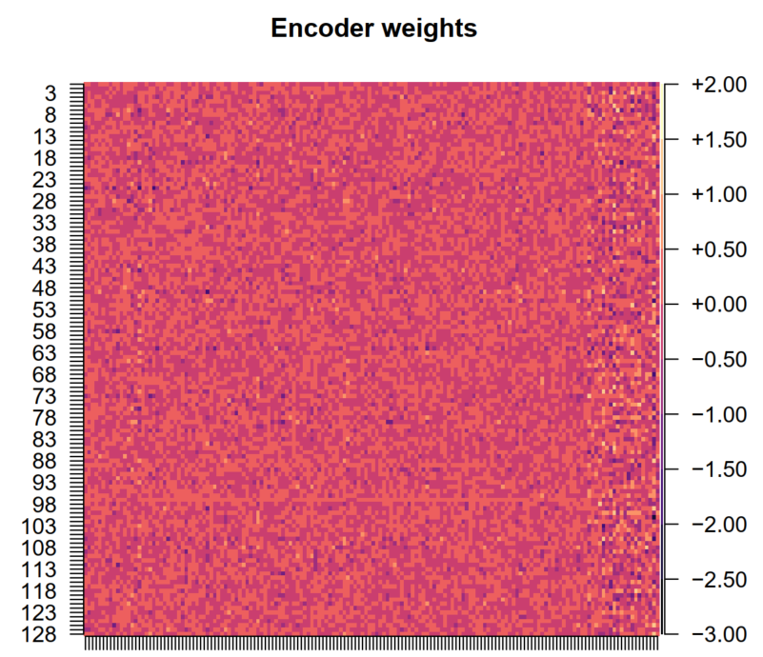
Finding spatially variable genes
z encodes spatial information...
How can we choose features in the original space (genes) that are important for determining the latent z?
Look at the encoder weights

Slide 23
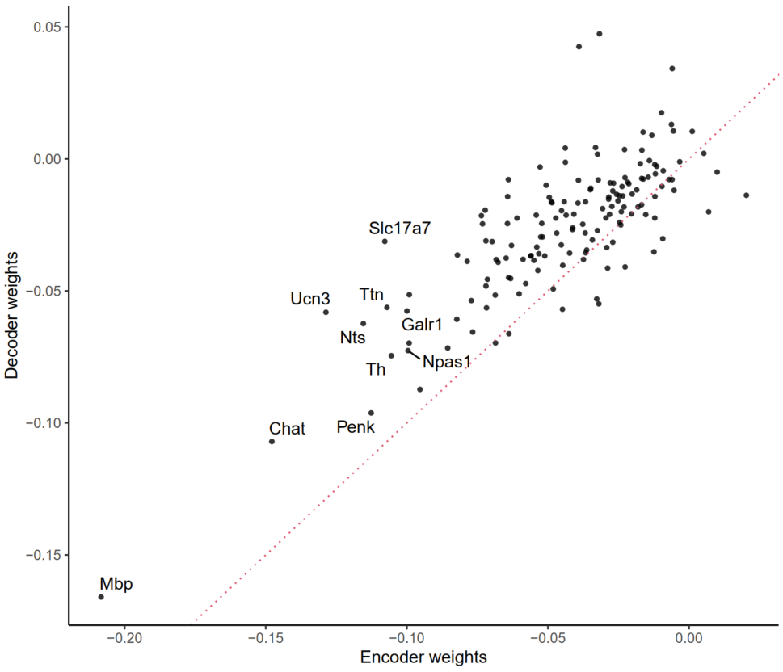
Finding spatially variable genes
z encodes spatial information...
How can we choose features in the original space (genes) that are important for determining the latent z?
Look at the encoder weights
Rank genes based on encoder weights

Slide 24
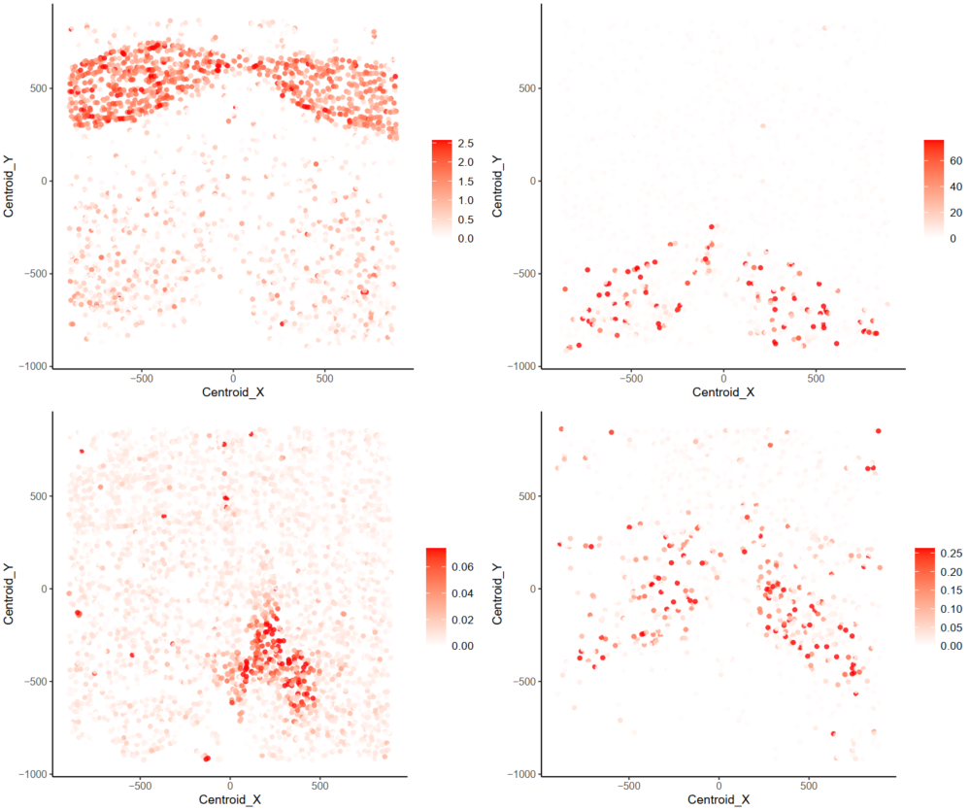
Finding spatially variable genes
Mbp
Chat
Ucn3
Penk

Slide 25
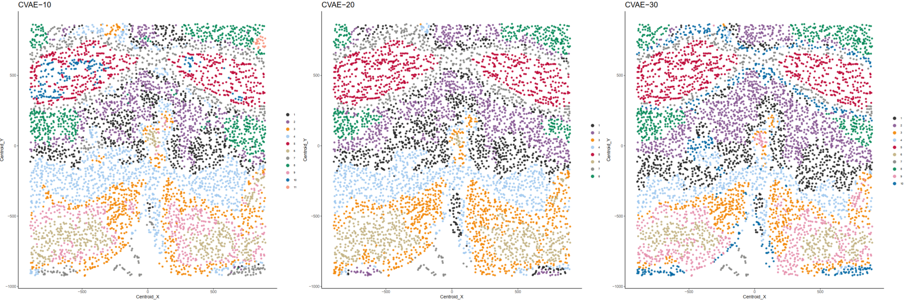
k controls scale of spatial structure
How does the number of neighbors chosen affect spatial clusters obtained from z?
Cluster latent spaces for k=10,20,30,40 at the same resolution
k=10, # clust=11
k=20, # clust=8
k=30, # clust=10

Slide 26
k controls scale of spatial structure
How does the number of neighbors chosen affect spatial clusters obtained from z?
Cluster latent spaces for k=10,20,30,40 at the same resolution
k=10, # clust=11
k=20, # clust=8
k=40, # clust=9

Slide 27
What’s next?
Interpreting CVAE clusters
Prediction of expression from a neighborhood (recontruction)
Obtaining potentially better reconstruction with GANs, VAE-GANS, ...

Slide 28
